Slide 1
PIC Microcontroller-based cryptosystem
By
Nadir Bengana
Assam Boudjelthia
Walid Nouicer

Slide 2
Forecast:
Communication between devices or people should be private, attackers mustn't be able to read it, and in some applications using computers would be economically inefficient. A sufficiently small and fast device would be more appropriate.

Slide 3
Motivation and problem statement:
Communication in a network is usually protected by multiple protocols that need whole computers.
Gsm network providers can listen to our conversations and a walkie talkie isn’t always secure.
A small, effective and secure way to send important data without a 3rd party acquiring it is needed

Slide 4
Motivation and problem statement:
We wanted to make a small device able to encrypt data and send it to another one and for that we used the PICF184550 as the heart or rather the brain of the device!
The device can be used in variety of other appliances like walkie talkies, pagers, door locks…etc.

Slide 5
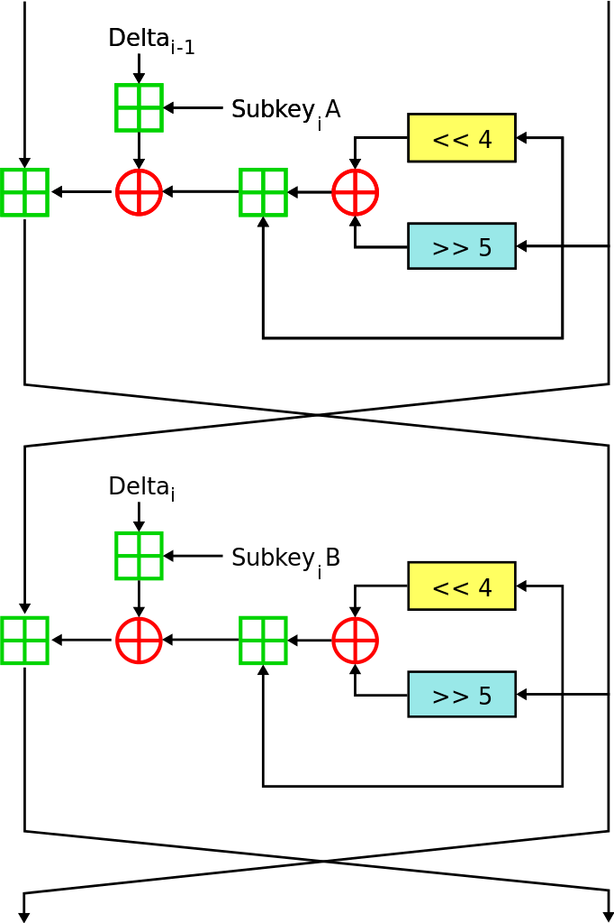
Methods: eXtended Tiny Encryption Algorithm(XTEA):
Based on Feistel cipher
More secure than TEA
More security with more rounds

Slide 6
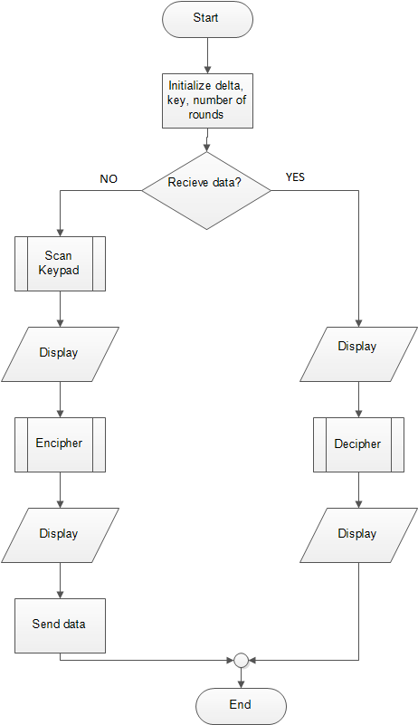
Flow chart:
The following algorithm is used.
It will use one program for both receiver and transmitter.
It can be modified in the future.

Slide 7
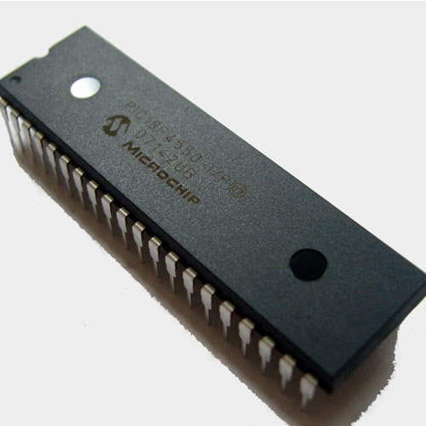
Why the PICF184550 ?
UP to 48Mhz
32kb of program memory
5 I/O Ports
Self Programmability
Other features

Slide 8
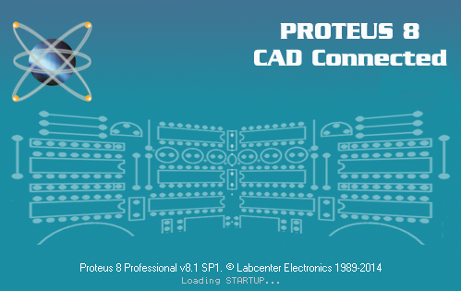
Circuit building:
The circuit was simulated using Proteus.
Proteus was used because of it’s huge library and compatibility.

Slide 9
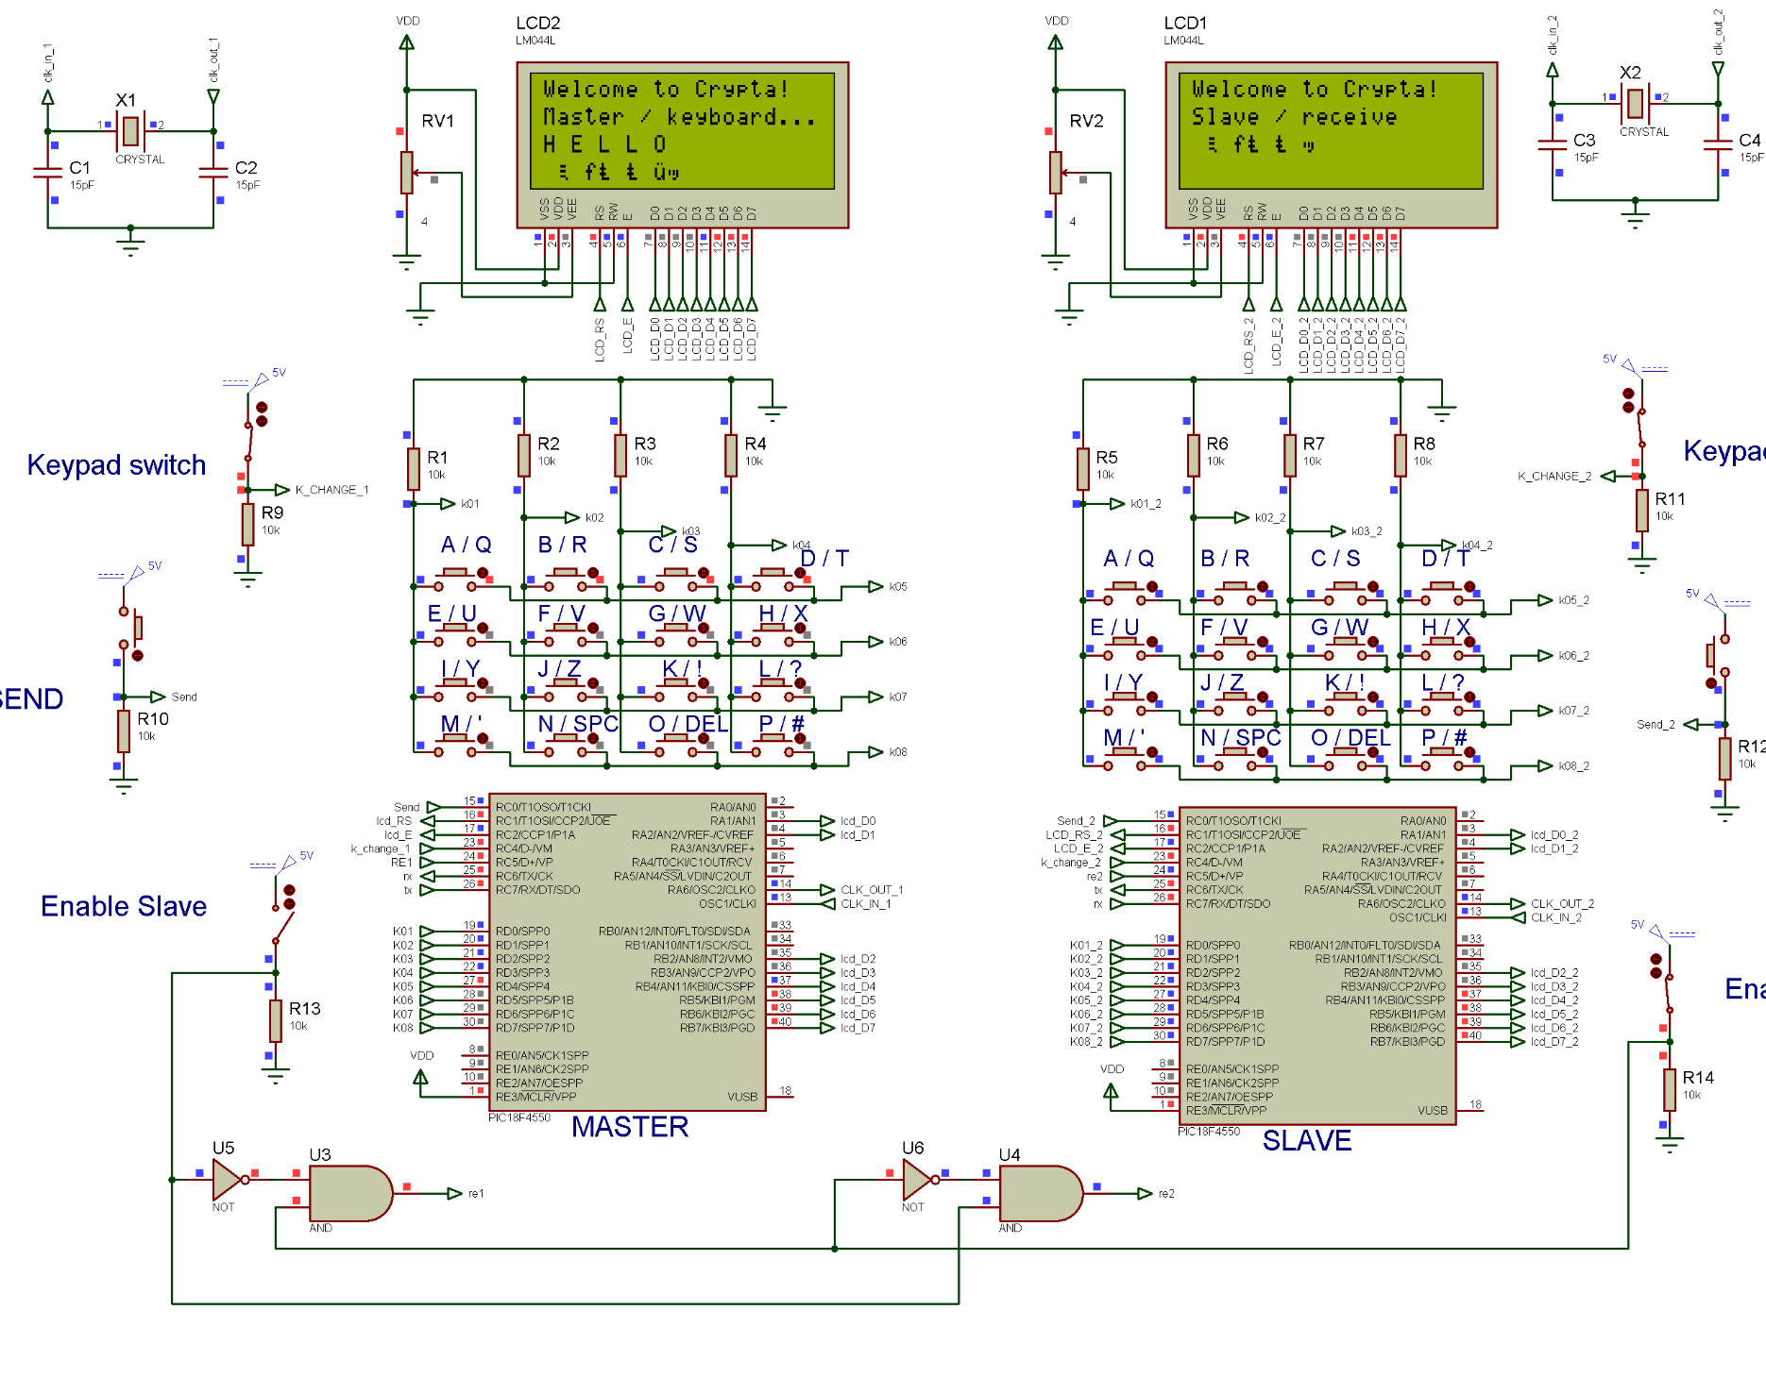
The circuit:
Master/Slave microcontrollers
Keyboard
20*4 LCDs
Oscillator
Slave select switch, and send button

Slide 10

Coding:
The language used was C.
The IDE used was MikroC pro.
All the codes were merged into one.
XTEA code was customised to fit the PIC18F4550.

Slide 11
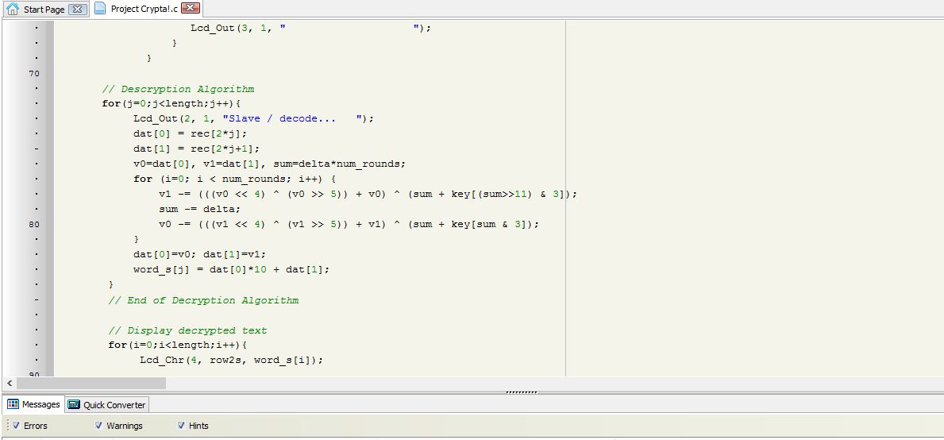

Slide 12
Summary:
Encrypting data using PICF18F4550 was a success.
The speed of the cryptography cycle was satisfactory.

Slide 13
Future work:
The key and number of rounds would be accessible to the user.
The algorithm can be upgraded into a more secure one.
Sending and receiving data will be wireless using an RF module.
Ciphering sound (or voice) for walkie talkies for example.

Slide 14
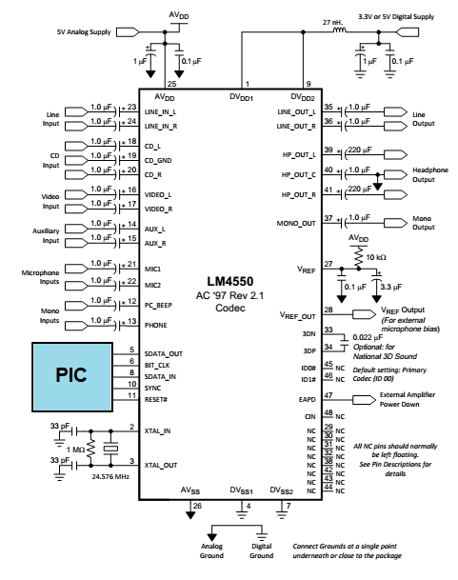

walkie talkies
Encrypt Sound for Walkie Talkie devices.
Multi-channel audio codec LM4550.
Send encrypted data through RF module, or Zigbee for small range use.

Slide 15
Thank you for your time !
Q & A section

